Slide 1
Reception Writing Workshop
December 2017
06.12.17

Slide 2
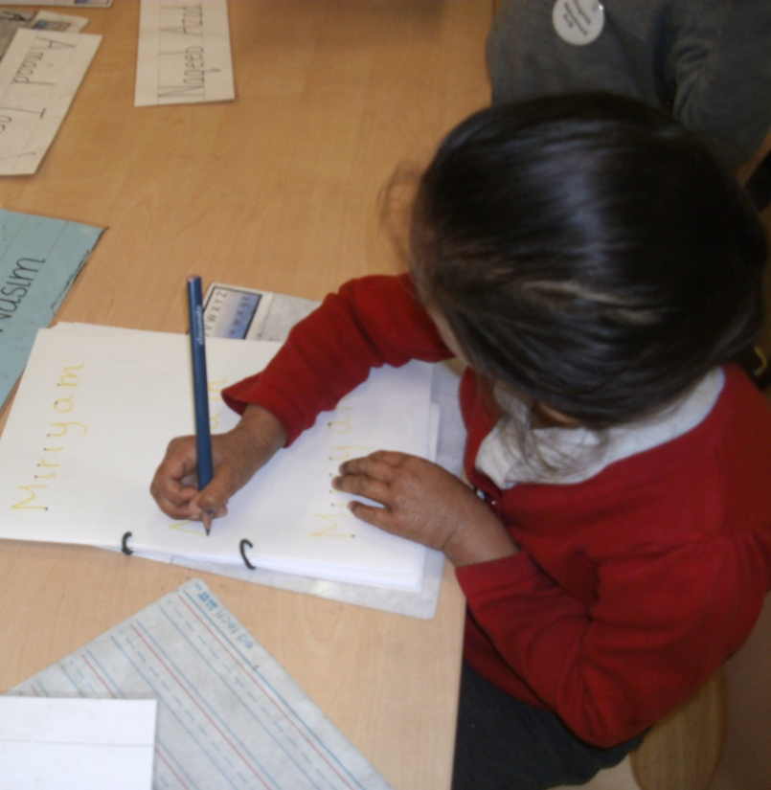
Name, writing words sentence writing on white boards every morning during soft start
Practising letter formation
Practising tricky words
Practising writing sounds in sequence
Practising sentence structure

Slide 3
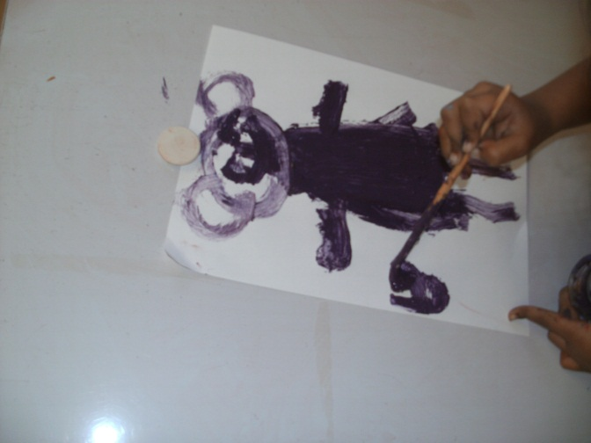
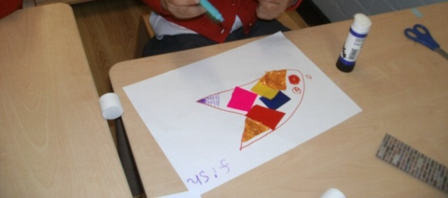
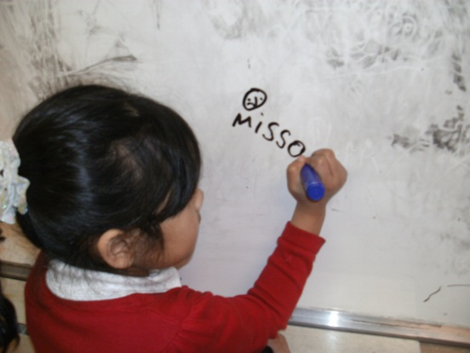
Writing for a purpose – labels, lists, cards, letters, stories…

Slide 4
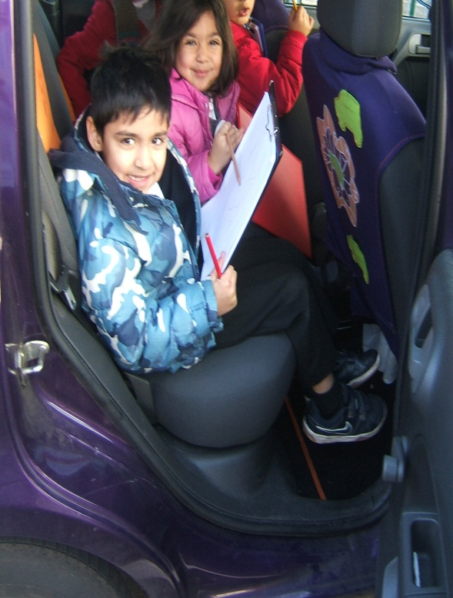
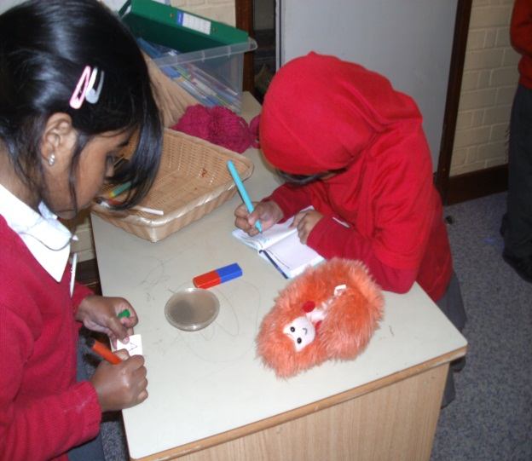
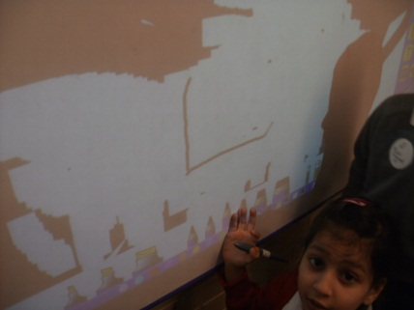
Inspiring children to make marks and to write…

Slide 5
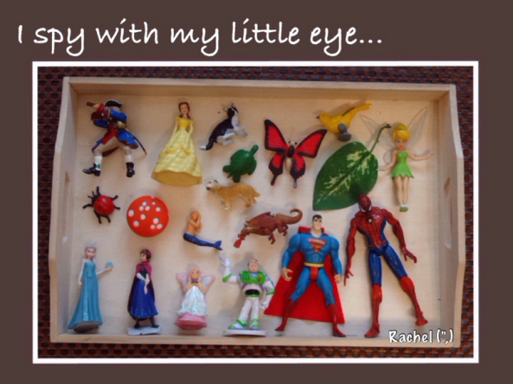
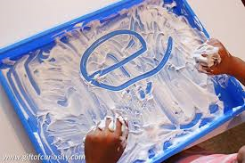
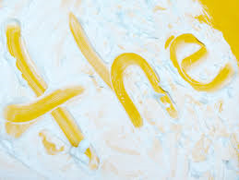
Supporting your child with writing
Make sure your child sees you writing.
Compose a letter together inviting a friend over to tea.
Make words together using magnetic letters.
Make up a story together about one of their toys. You write for them, repeating the sentences as you write. When complete they can draw pictures to go with it and then challenge to label or write a short sentence about their picture.
Buy stickers of a favourite film or TV programme – and make a book about it.
Ways you can support your children at home: other things to do at home
Turn off technology so you can listen to and talk to your child.
Read every day to your child.
Set up a place where your child can experiment with mark making both outside and inside using shaving foam, paint, pens, stamps, and stencils onto a variety of surfaces such as paper, cardboard and material.
Collect a variety of pencils and pens, and keep them handy for your child.
Create a special writing bag to keep little writing tools in for travelling in the car or visiting places. Change the contents regularly.
Word train words

Slide 6
Stages of Writing

Slide 7
EYFS Early Learning Goal in Writing:
Children use their phonic knowledge to write words in ways which match their spoken sounds.
They also write some irregular common words.
They write simple sentences which can be read by themselves and others.
Some words are spelt correctly and others are phonetically plausible.

Slide 8
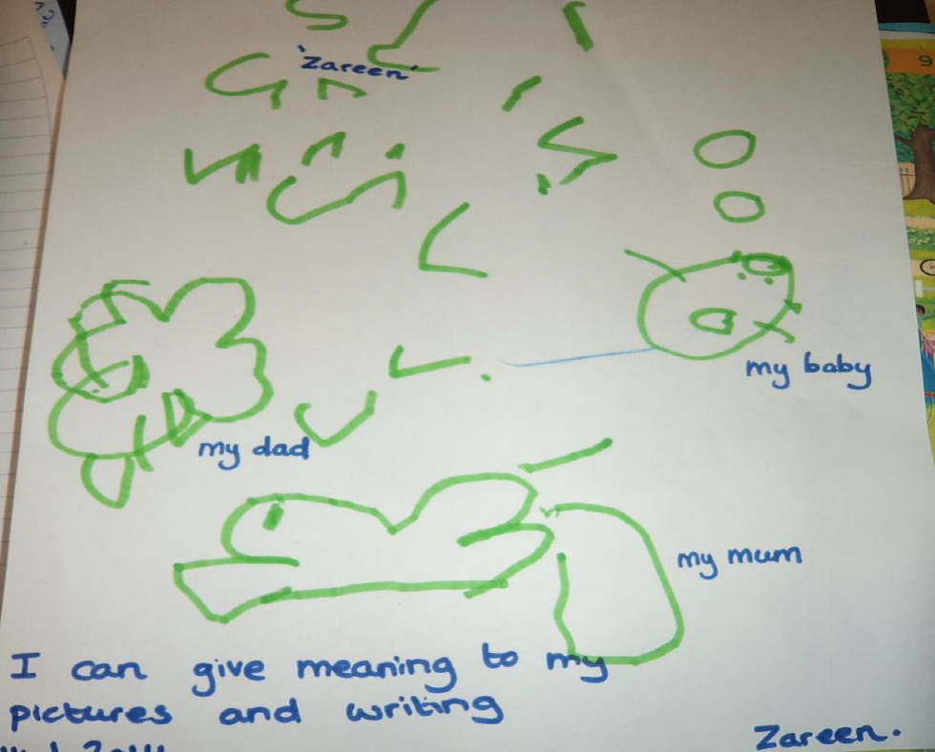
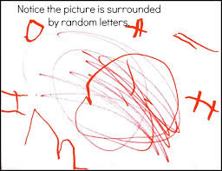

Children understand that writing is a form of communication and that their marks convey meaning.

Slide 9
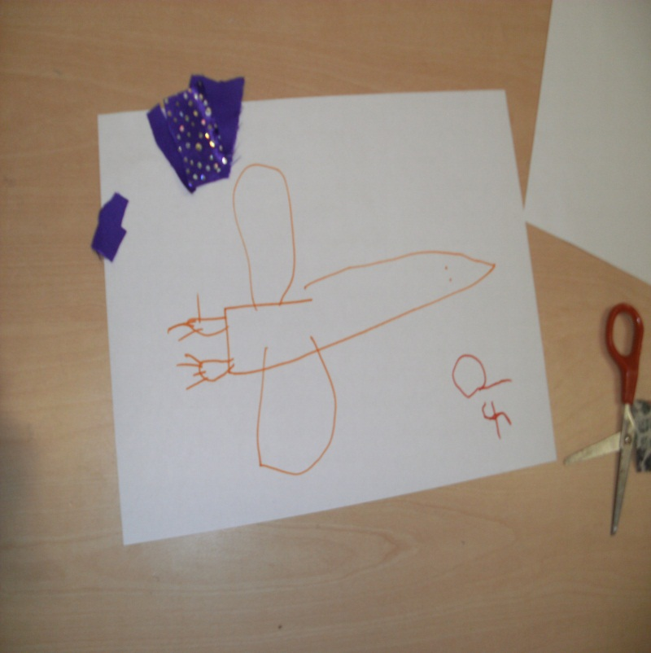
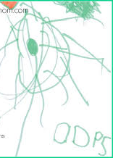
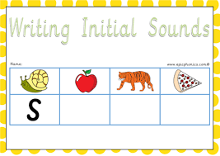
Hears and says the initial sound in words. Can segment the sounds in simple words …

Slide 10
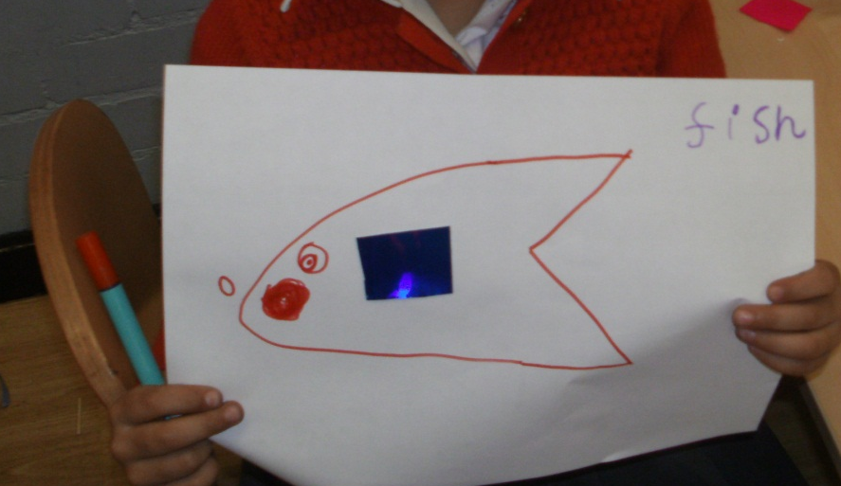
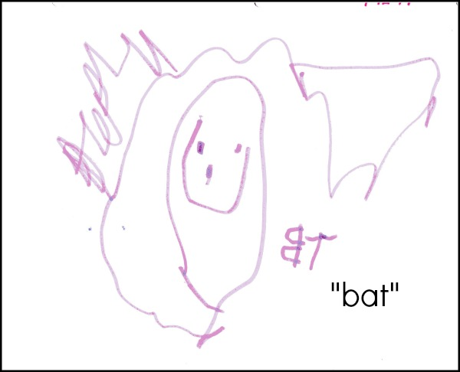
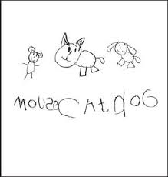
Uses some clearly identifiable letters to communicate meaning, representing some sounds correctly and in sequence.

Slide 11
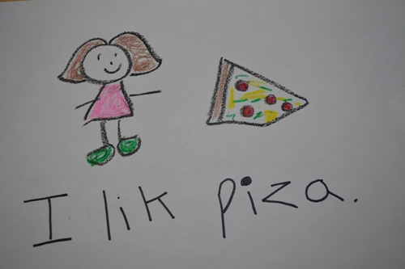
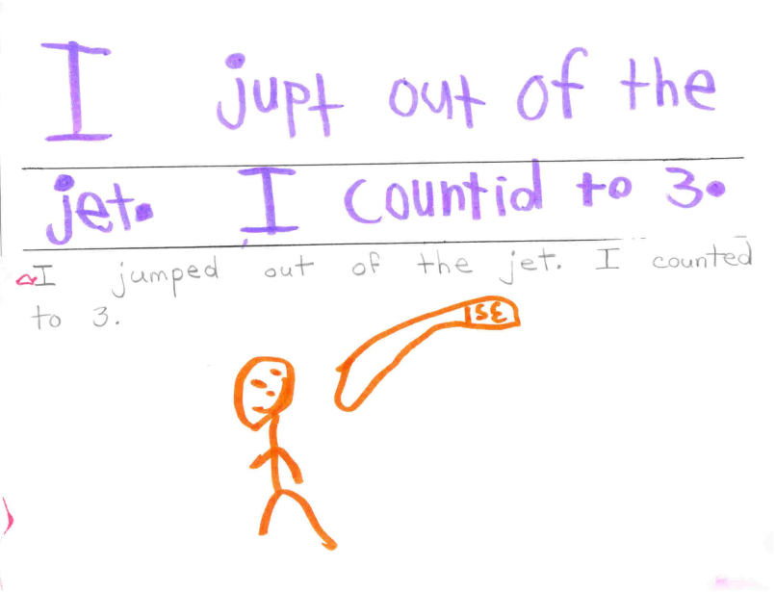
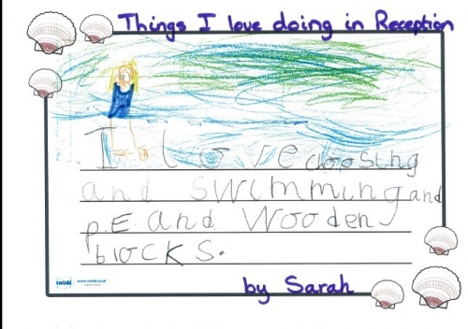
Writes own name and other things such as labels, captions. Attempts to write short sentences in meaningful contexts.

Slide 12








Our Writing Symbols
C
®
s
Full stop capital letter finger spaces use your robot arms letters sitting on line check your work
Challenge!
because
and
a
Adjective conjunction
icanrunupthehill
How can we improve this sentence?
I can run up the green hill and run back down again.

Slide 13
Possible sentence starters to use at home:
I can …. run, jump, hop,
I can see a …. pig, dog, cat, man
I went to the … park, swimming pool
I like to go to the …. shop,
I like to …. because ….
The cat sat on the mat and he fell asleep.
The cat sat on the mat because he was tired.

Slide 14
Teacher to model
writing a sentence

Slide 15
Questions

Slide 16
Thank you for coming!
Write a shopping list with your child.
Take it to use on your next shopping trip!

