Slide 1
Parent Portal
During the session we will cover:
How to login to parent portal.
What the icons mean.
How to access the reports, newsletters and messages from the school.
How to login more than one child.

Slide 2
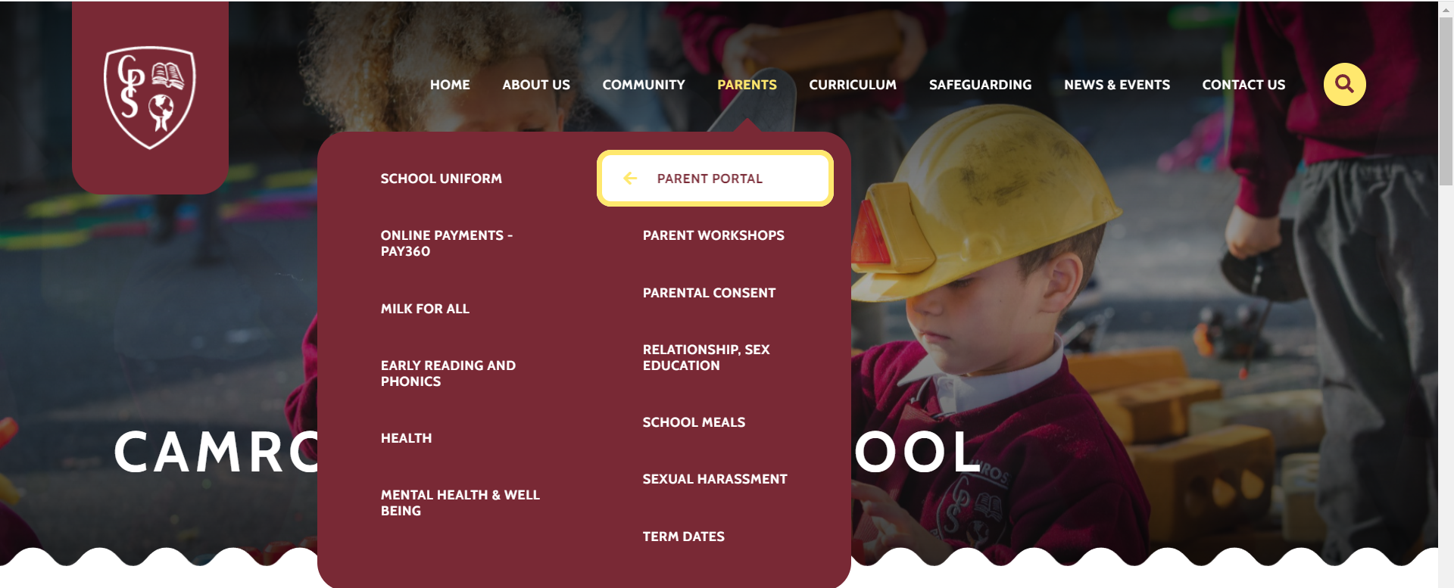
1. Open your web browser and search “Camrose primary school,” then click on the website.
2. Click on parents then open parent portal

Slide 3
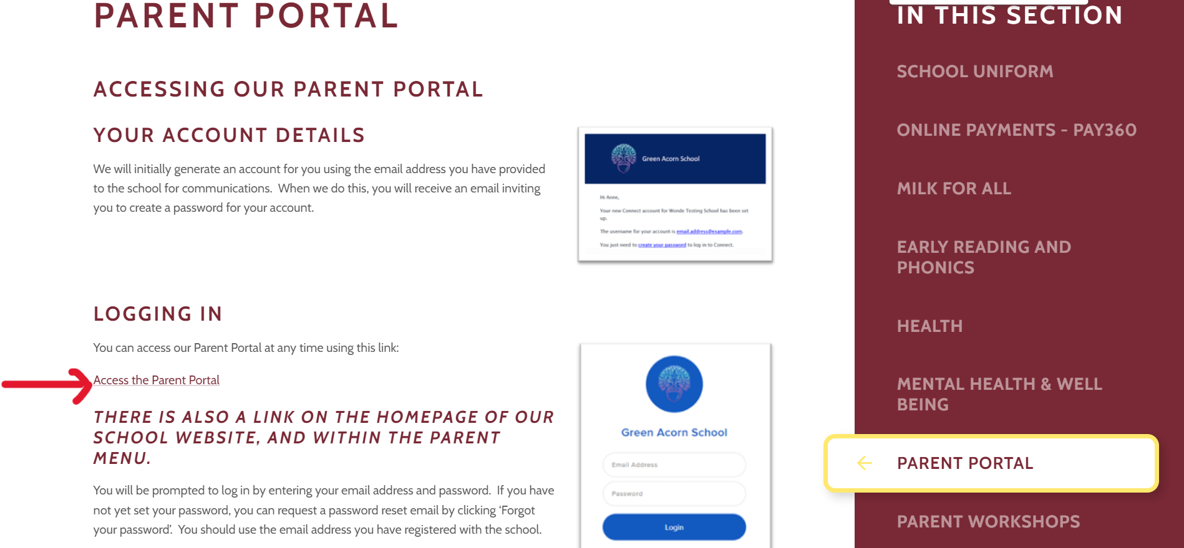
Click on Access the Parent Portal

Slide 4
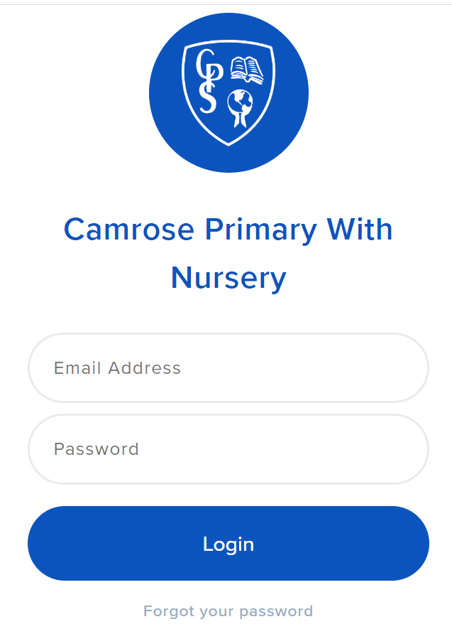
You will see this page, enter your login details here.

Slide 5
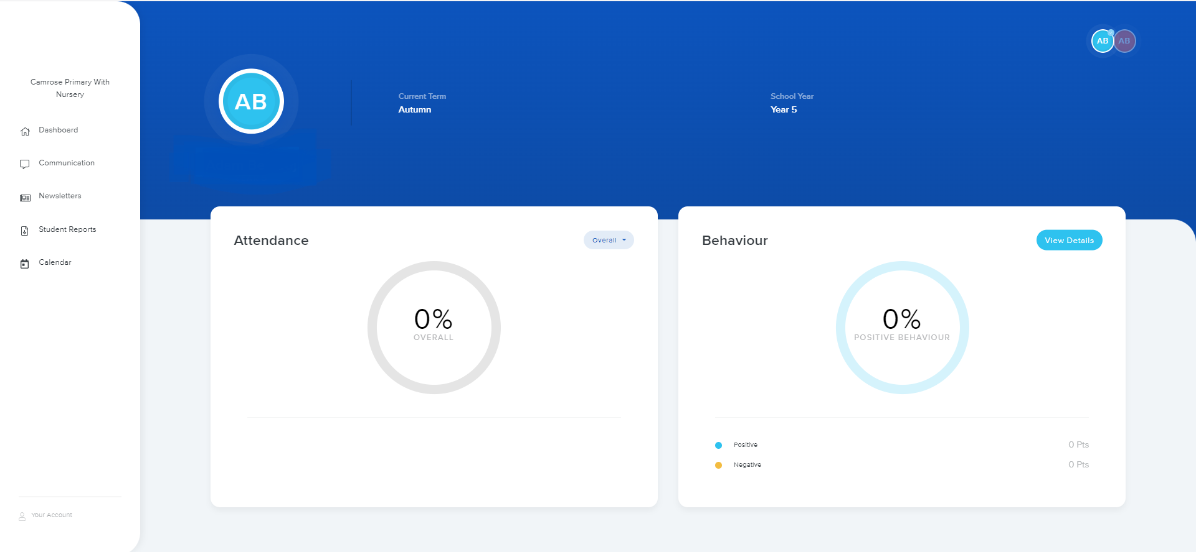
You can see your child’s name, attendance, behaviour and the menu. For more than 1 child; on a laptop you need to click on the next name in the top right hand corner, on a phone/tablet you need to swipe.

Slide 6
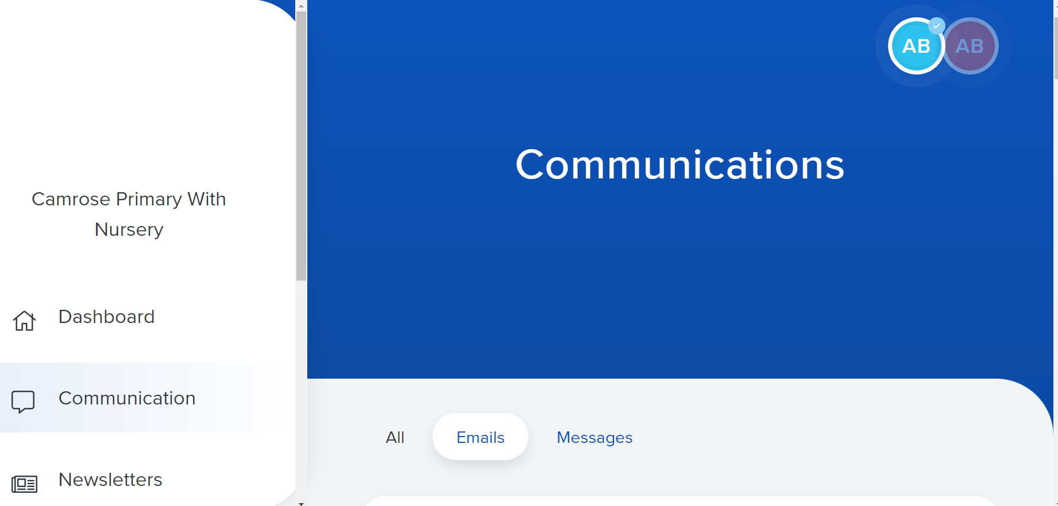
1-Emails: we find all the letters about events on school or remainders. 2-Messages:we find any messages about you child from the school.
In communication we see two sections :

Slide 7
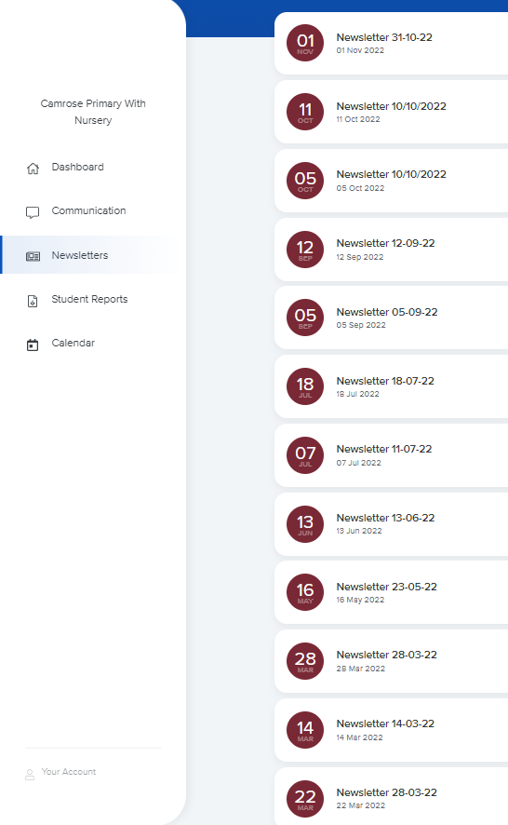
Student reports
Newsletters
Here you can see all the latest newsletters from the school.
In student reports, you can see your children’s’ reports.

Slide 8
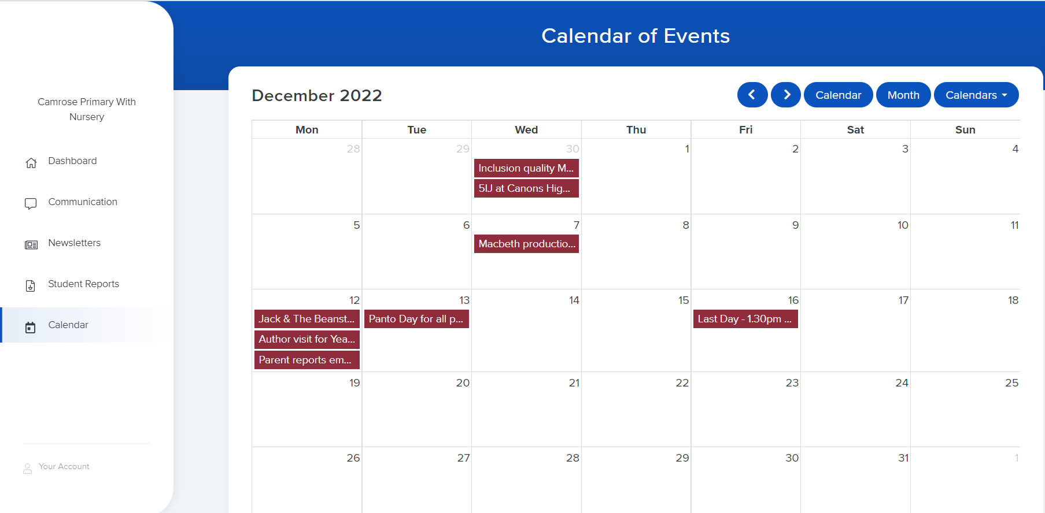
Here you can see all the term dates and school which are shaded in.
Calendar of events

