Slide 1
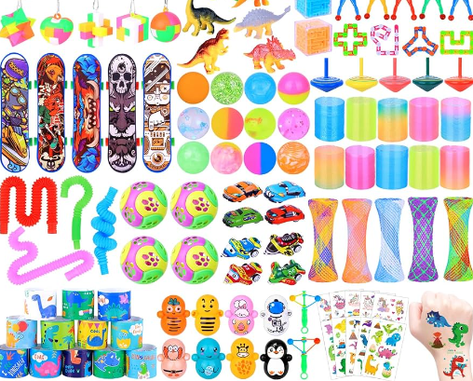
Camrose Fundraiser for Jigsaw Families
Tuesday 5th March
and
Wednesday 6th March
3:00pm – 3.40pm
Outside the school office
LUCKY DIP FOR £1.50!
Come and buy some
stationary!
Have the chance to speak to our parents and staff about our interactive program.

